Slide 1
Socket Programming
BY
Rajesh Chavre (CS19BTECH11030)
Samar Garg (CS19BTECH11033)
Naitik Malav (CS19BTECH11026)
Jatin Kumar (CS19BTECH 11036)
Md Nazish Kaunain (ES19BTECH11006)

Slide 2
What is a socket?
A socket is a communications connection point (endpoint) that you can name and address in a network.
Socket programming shows how to use socket APIs to establish communication links between remote and local processes.
The processes that use a socket can reside on the same system or different systems on different networks.
Sockets are useful for both stand-alone and network applications.
Sockets allow you to exchange information between processes on the same machine or across a network, distribute work to the most efficient machine, and they easily allow access to centralized data.

Slide 3
Server-Client Communication
Server has a socket that is bound to a specific port number
The client has the information of the machine on which the server is running and the port number on which the server is listening
The client makes a connection request to connect with the server on the server’s machine and port
The server accepts the connection.
After accepting the connection, the server creates a socket, and the the client can use the socket to communicate with the server.

Slide 4

Socket()
Bind()
It is used in creating endpoint for a network connection.
Bind() is called by server process to attach server to a specific port and IP address.

Slide 5
Listen()
Accept()
Listen() is called by server to tell kernel to initiate a wait queue of connections for a socket.
Server process calls Accept() to accept new connections from new clients trying connect to a server.

Slide 6
Connect()
Send/Recv
Close()
Client calls connect() to connect to a server port.
To send and receive data we use send() , recv().
This operation is end of communication between server and client pair.
It closes socket effectively.

Slide 7
SERVER
socket
bind
listen
accept
recv
send
recv
close
Establishing connection 3-way handshake
Server creating listening socket
Server sending data, client receiving data
Client sending close message
Client sending data, server receiving data
CLIENT
socket
connect
send
recv
close

Slide 8
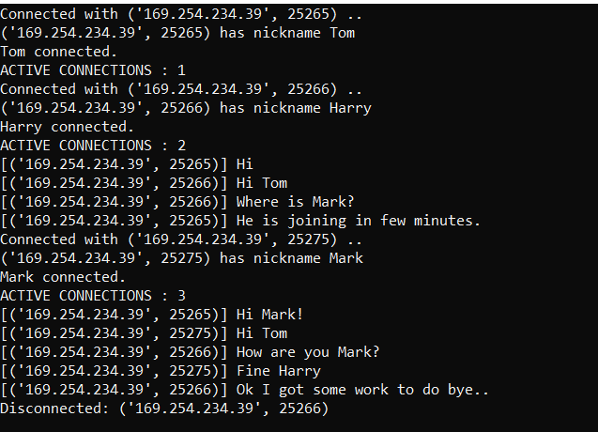
Here is Execution of out program-
In which there are 3 friends are doing group chat after connecting to server
This is server

Slide 9
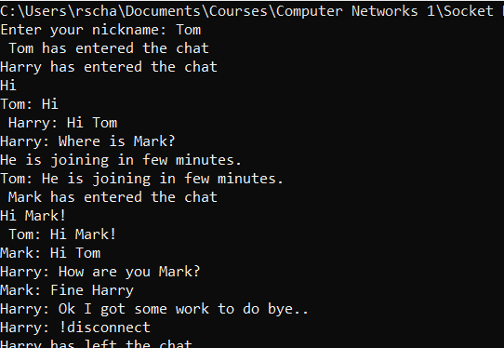
TOM

Slide 10
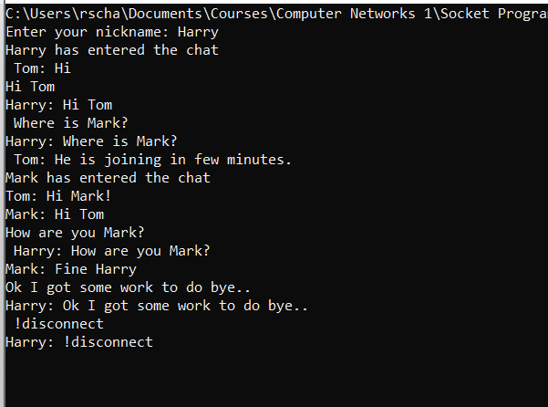
Harry

Slide 11
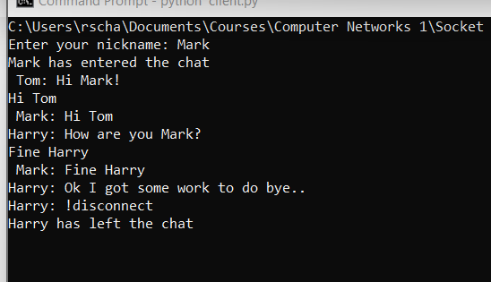
Mark

